Slide 1
Plesu Catalin
Weird jobs

Slide 2
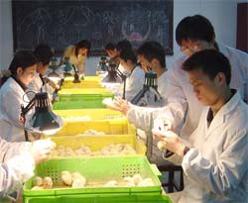
Chicken sexer
Someone who determines the sex of chickens.

Slide 3
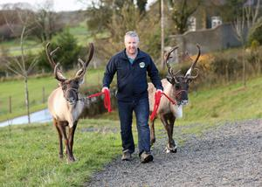
Reindeer Walker

Slide 4

Zombie
Working as a zombie at the London Dungeons will bring in a substantial salary

Slide 5

Exorcist
An exorcist is a Roman Catholic priest who drives out evil spirits, demons, and devils from possessed people, places, and things.

Slide 6

Phornographyc historian
A really good job ( urbandictionary)

Slide 7
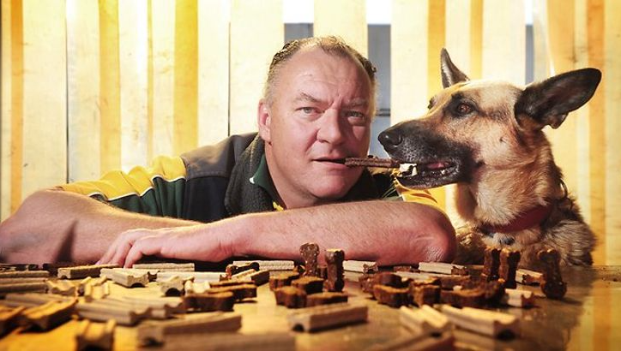
Pet Food Tester

Slide 8
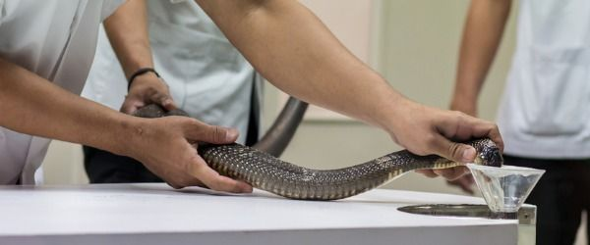
Snake Milker
Snake venom (poison) can be used for many things, but the most important is its use in medical research or to produce "antivenom."

Slide 9
vocabulary
Learn the Ropes - Become more familiar with a job or field of endeavor; be trained
Get the Sack/ Be Sacked - To be fired
Off the Hook - Free from blame or responsibility to do something
Burn the Candle at Both Ends - Work very long hours
Move Up in the World - Become more successful
NEET - an acronym for "Not in Education, Employment, or Training"

